Slide 1

IALA developments of e-Navigation services
Jon Leon Ervik
Head of Department

Slide 2
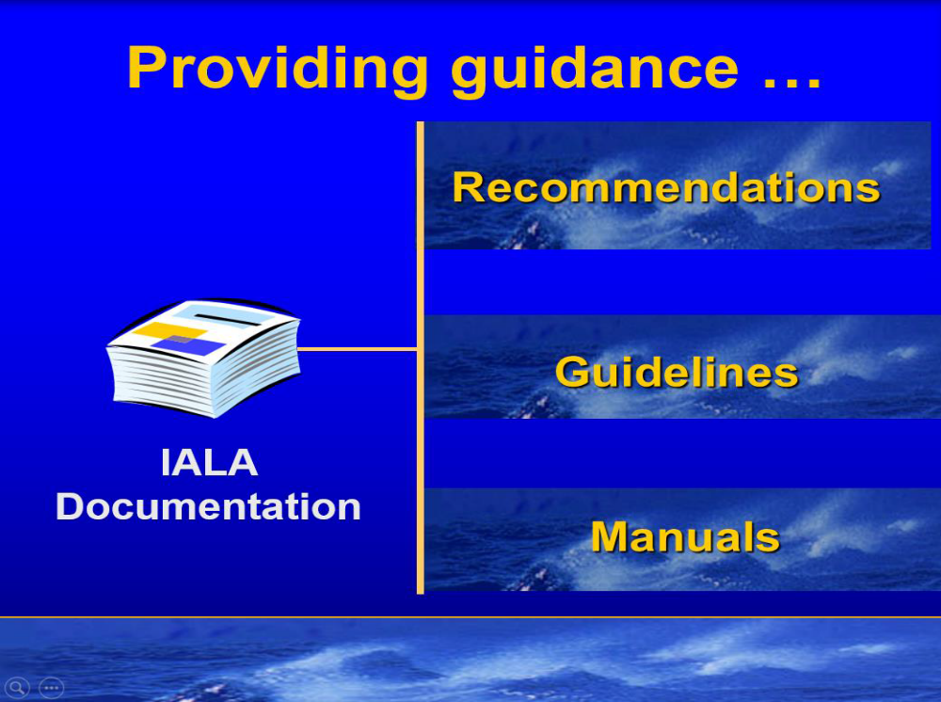

Slide 3
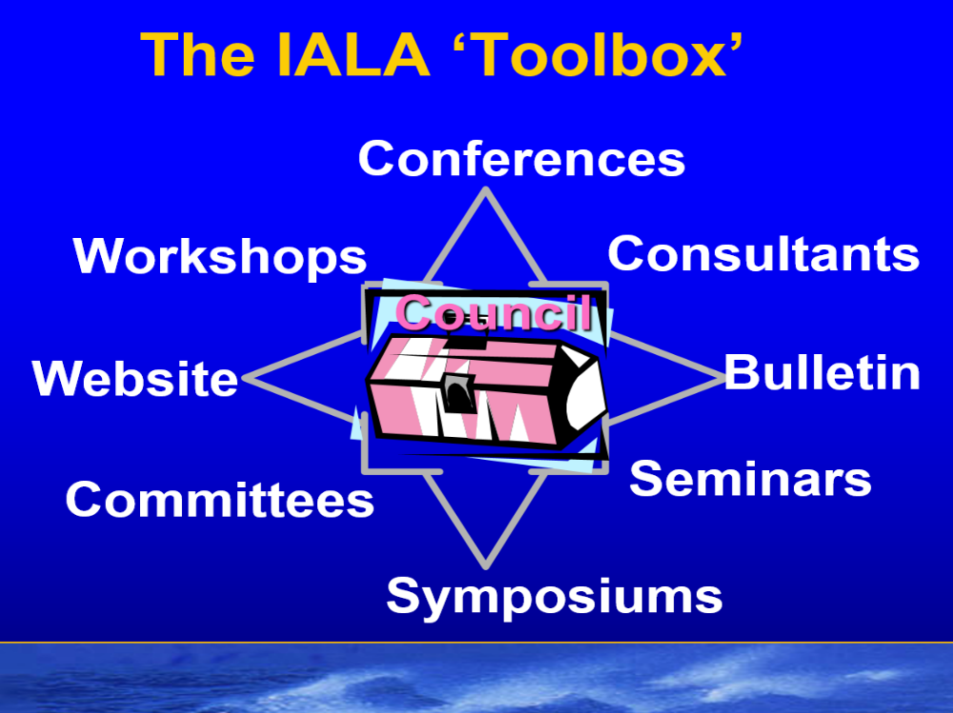

Slide 4
IALA e-Navigation Committee
WG 1 - Data modelling and message systems
WG 2 - e-Navigation test beds
WG 3 - Shore technical infrastructure
WG 4 - Maritime Service Portfolios
WG 5 - e-Navigation communications

Slide 5

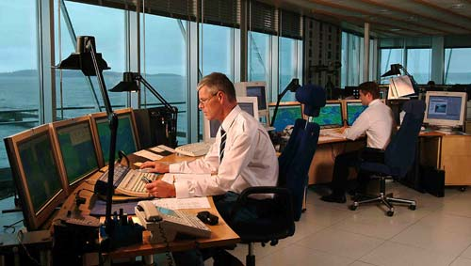
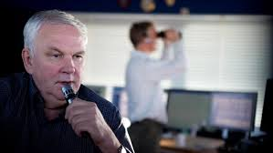

Slide 6
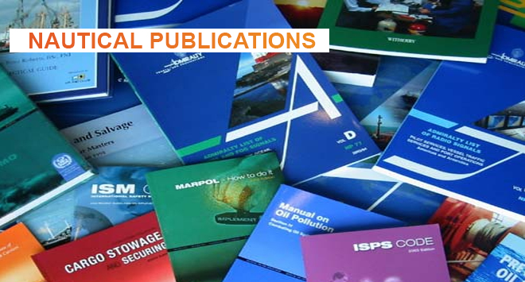
MSP 12 – nautical publications

Slide 7
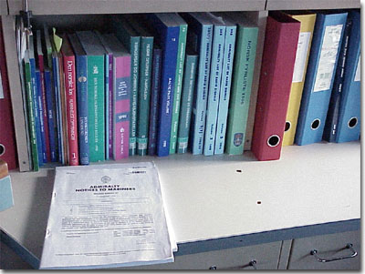
User-friendly?

Slide 8
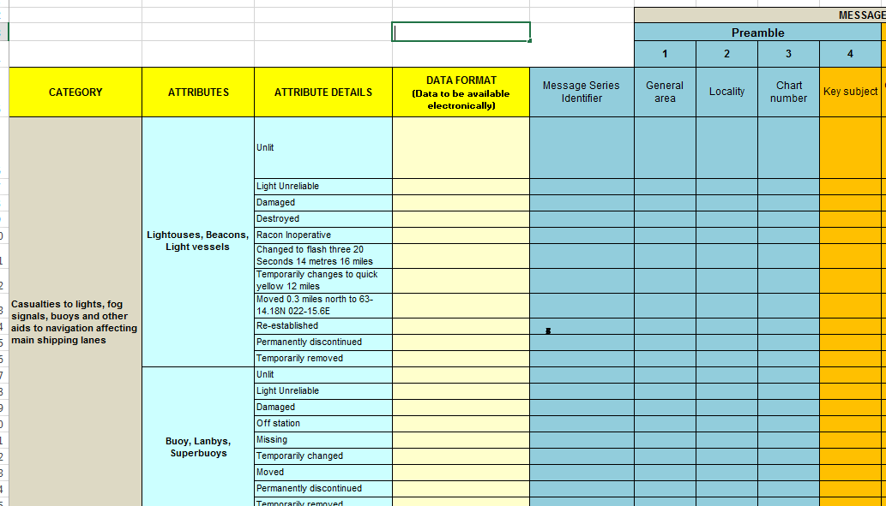

Slide 9
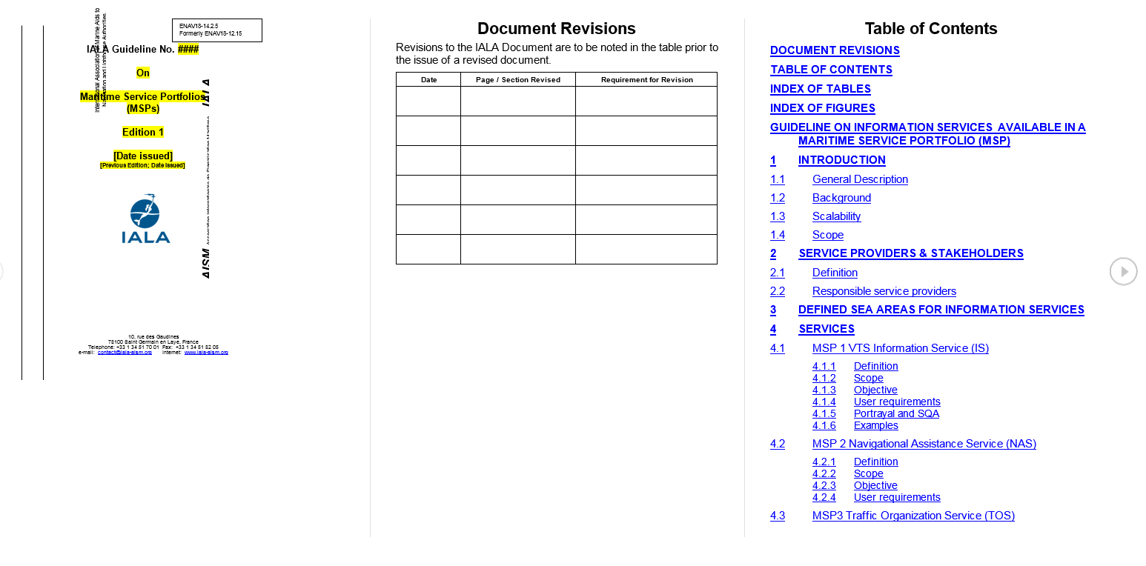

Slide 10
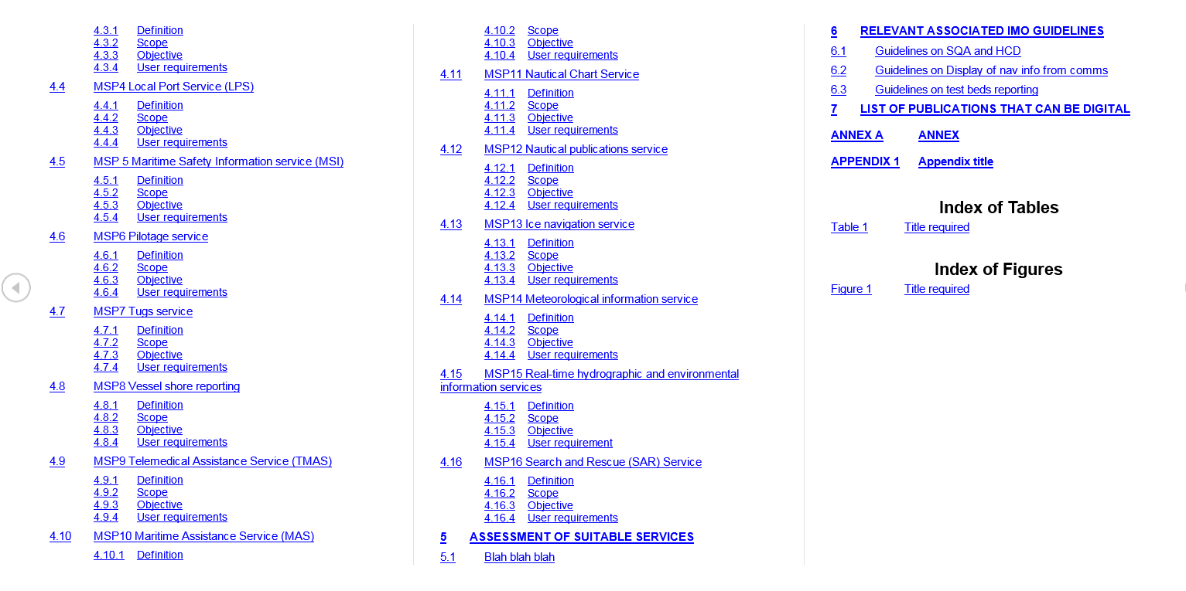

Slide 11
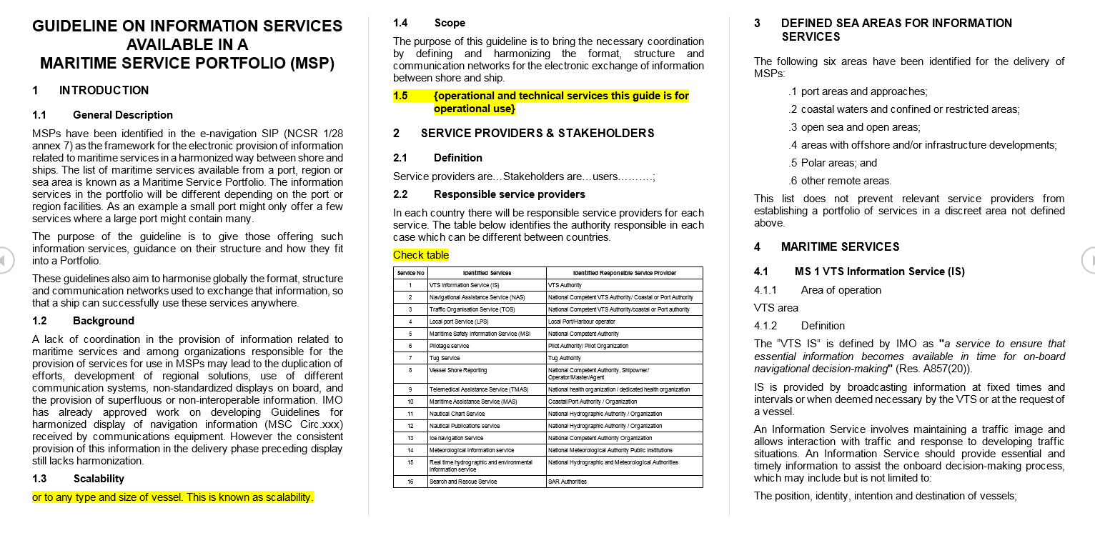

Slide 12
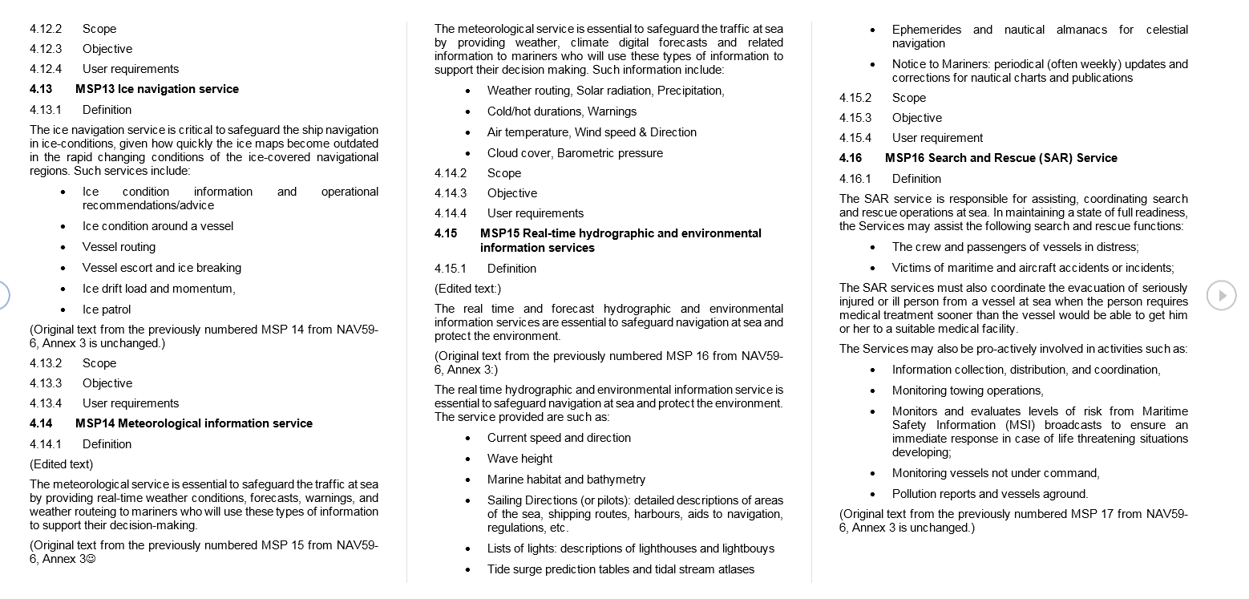

Slide 13
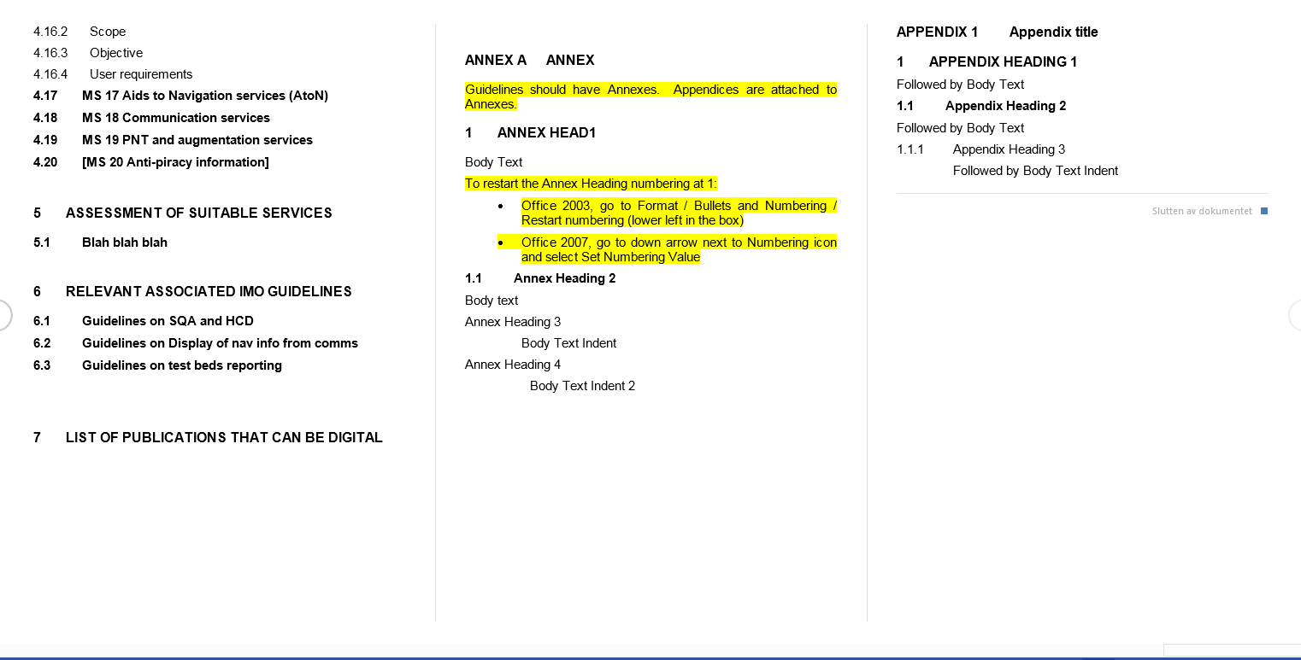

Slide 14


Thank you
Notes:
I would like to repeat what e-navigation is about.
It is about how to get the ship safely, securely and efficiently from berth to berth in an environmentally friendly way, using globally enhanced systems for navigation and communication – with the human element in focus
Thank you!

